Slide 1
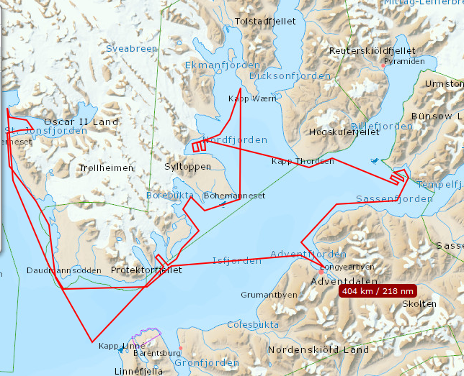

ADAMANT – ACCES projects
s/y Magnus Zaremba plan 2019
22-24 VII Gipsvika
25- 25 VII Yoldiabukta
26 VII Ekmanfjorden
27 VII Borebukta
28 VII Forlandsundet
29 VII St. Johnsfjord
30 VII Forlandsundet
31. VII Longyearbyen

Slide 2
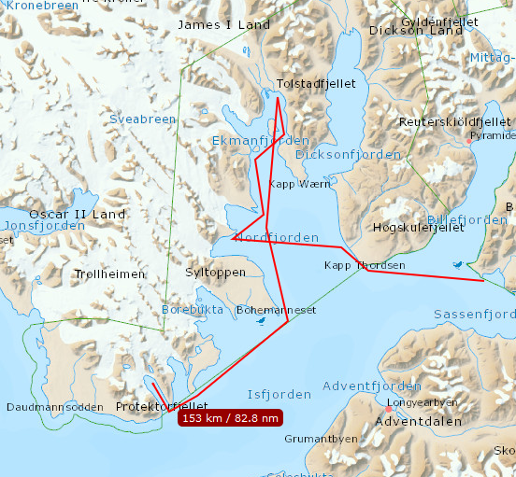

ADAMANT – ACCES projects
Bombard – coastal plan 2019
22-24 VII Gipsvika
24- 25 VII Yoldiabukta
26 VII – 27 VII Ekmanfjorden
28 – 30 VII Tryghamna
31 VII Longyearbyen

Slide 3
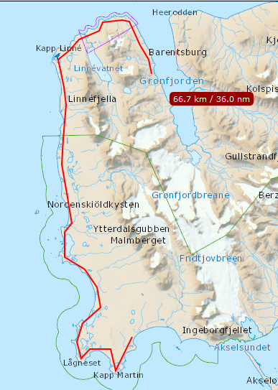

ADAMANT – ACCES projects
Coastal group plan 2019
28 VII Sletnessbukta
29 VII Lagneset
30 VII Osodden
31 VII Stabbane
1 VIII Revleodden
2 -3 VIII Linneelva – Russekeila
4 – 5 VIII Gronfjorden – Kokerinset
6 VIII Longyearbyen

